Slide 1



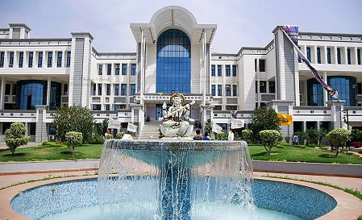




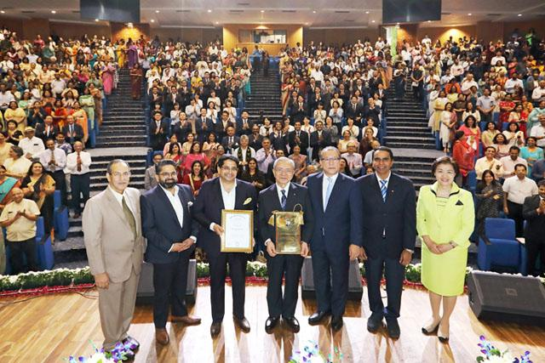
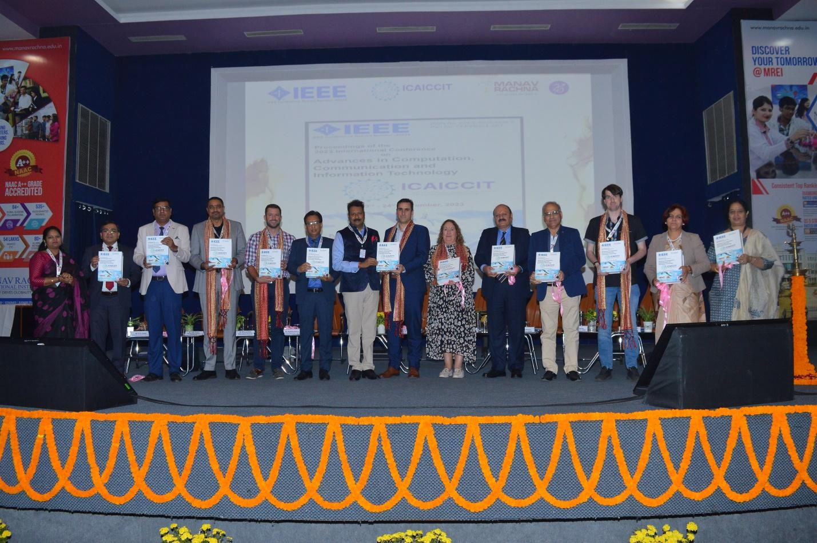

ICAICCIT-2025, 3rd International conference on Advances in Computing, Communication and Information Technology, technically Co-Sponsored by IEEE Delhi SECTION (IEEE record no # 68829)
on 31st Oct & 1st Nov. 2025

Slide 2
Learning Ridge Structures: Adaptive CNN-Based Local Orientation and Frequency Estimation for Fingerprints
Paper id: ICAICCIT_0580
Presented by
Atmakuri Jashwanth
Atmakuri Jashwanth, Shaik Inkollu Farzan Basha, Yalagala Leela krishna, Syed Rizwana, K.V. NarasimhaReddy
Narasaraopeta Engineering College, Narasaraopet
Rama Sundari (GRIET, Bachupally, Hyderabad)
Velagaleti Sesha Bhargavi ( G. Narayanamma Institute of Technology Science(women), Shaikpet, Hyderabad)

Slide 3
Index -
Introduction
Problem Statements
Objectives
Literature Review
Methodology
Result & Discussion
Conclusion & Future Scope
References

Slide 4
Introduction:
Fingerprint recognition is a widely used and reliable biometric technique due to its uniqueness
and permanence.
Key structural features: Ridge Orientation and Ridge Frequency essential for enhancement,
minutiae extraction, and matching.
Traditional methods (gradient & Fourier-based) perform well on clean images but fail on noisy
or low-quality fingerprints.
Adaptive CNN-based model proposed to jointly estimate ridge orientation and frequency directly
from raw images.
Model includes XSFFE and SNFFE preprocessing for noise reduction, normalization, and data
consistency.

Slide 5
Problem Statements:
Existing methods fail on noisy and low-quality fingerprints.
Traditional filters lack adaptability to real-world variations.
CNN models trained on clean data show poor generalization.
No large ground-truth dataset for ridge frequency estimation.
Patch-based analysis loses global ridge structure information.
Need for an adaptive CNN that can accurately estimate ridge orientation and frequency in real time.

Slide 6
Objectives :
Our Research work aims to:
To design an adaptive CNN model for ridge orientation and frequency estimation.
To improve fingerprint image quality using XSFFE and SNFFE preprocessing.
To achieve robust performance on noisy or low-quality fingerprints.
To ensure real-time execution with high accuracy.
To evaluate model performance using MAPE and benchmark comparisons.

Slide 7
Literature Review :
Existing Research:
Gradient & Fourier-based methods: Effective for clean images but fail on noisy or partial
fingerprints.
Filter-bank approaches (Gabor, Butterworth): Improved ridge estimation yet struggle with
severe distortions.
CNN-based models: Enable joint extraction of ridge features and texture patterns.
Dual-branch adaptive CNNs: Estimate both orientation and frequency with attention
mechanisms.
Identified gap: Lack of robust, dense pixel-wise, end-to-end models for real-world fingerprint
data.

Slide 8
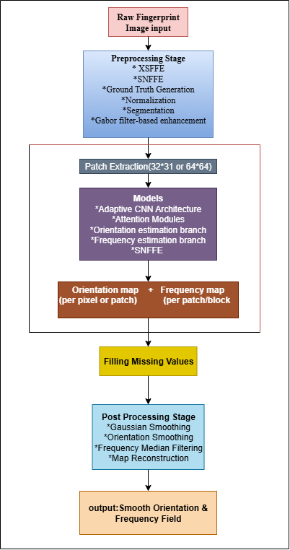
Methodology :
Pipeline Overview :
1. Raw fingerprint image input: FFE dataset containing
fingerprint images for processing.
2. Preprocessing stage: XSFFE & SNFFE, normalization,
segmentation, and optional Gabor-based enhancement to clean
and standardize ridge patterns.
3. Patch extraction: split image into local patches (e.g., 32×32 or
64×64) to capture local ridge structure.
4. Model (Adaptive CNN): multi-branch network with orientation
and frequency estimation branches (plus attention/SNFFE
support).

Slide 9
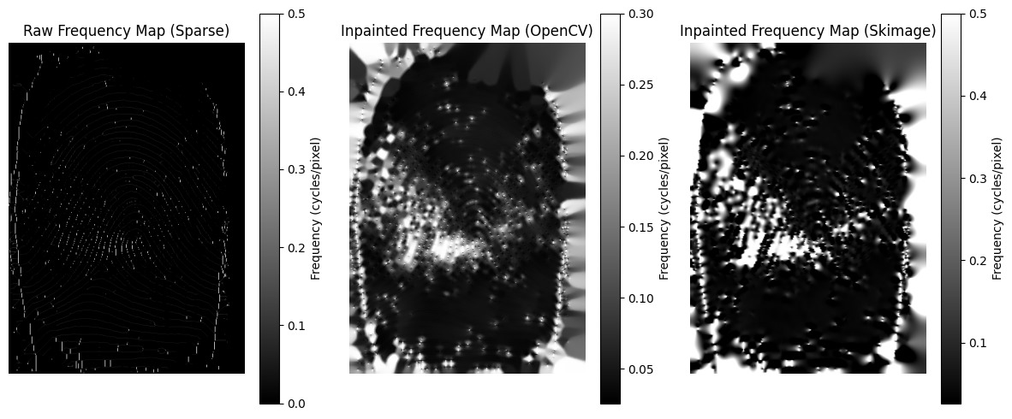
5. Generate maps: produce local orientation map and frequency map (per pixel or per patch).
6. Fill missing values: inpaint or interpolate sparse/invalid regions to ensure continuity.

Slide 10
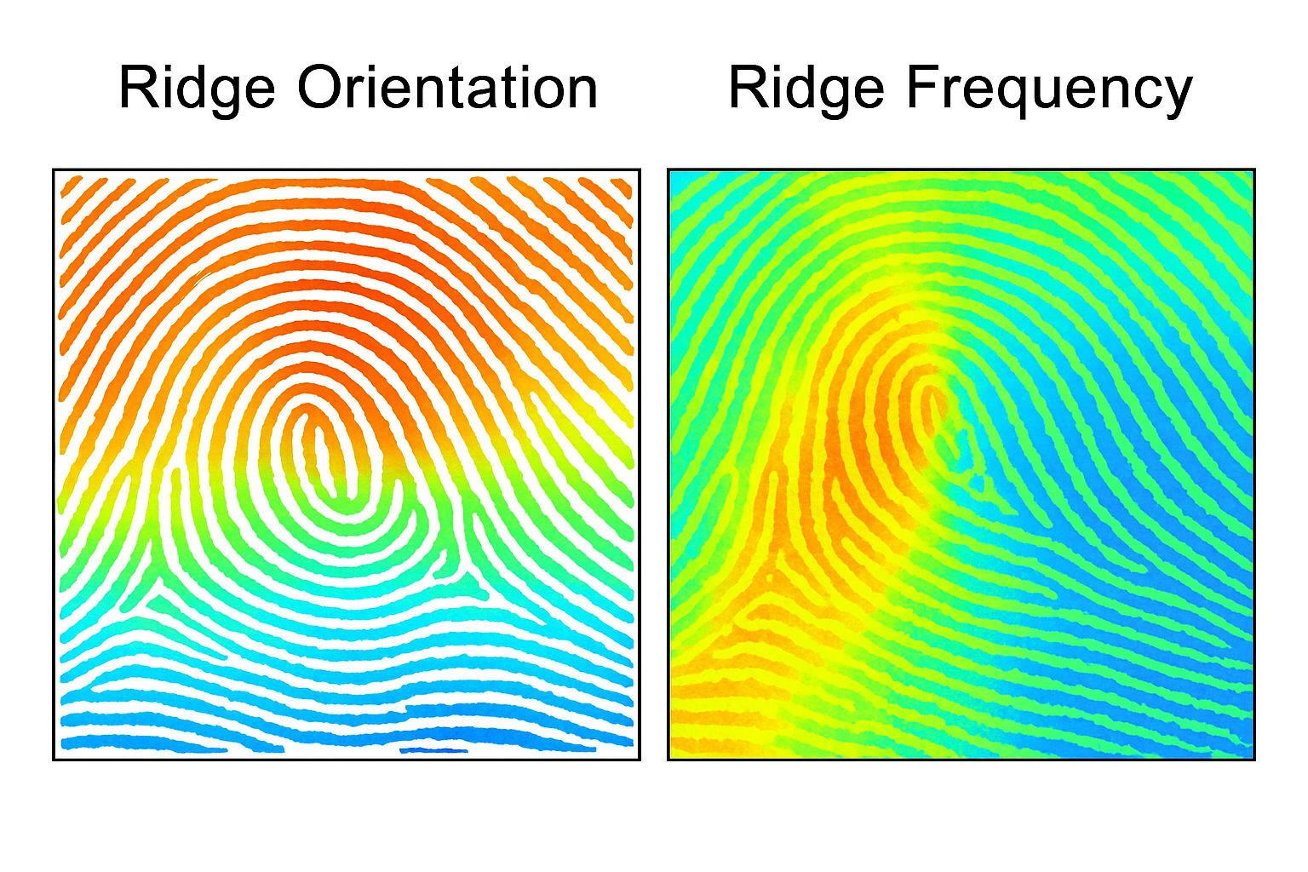
7. Post-processing: Gaussian smoothing, orientation smoothing, median filtering for frequency,
and map reconstruction.
8. Final output: smooth, robust orientation & frequency field ready for enhancement, minutiae
extraction, and matching.

Slide 11
Result & Discussion:
1. Proposed Adaptive CNN achieved MAPE of 4.58% (good) and 5.02% (degraded).
2. Outperformed baseline CNN and traditional frequency regression models.
3. Execution time: 0.012 seconds per image → suitable for real-time applications.
4. Enhanced ridge clarity and continuity in noisy or smudged fingerprints.
5. XSFFE + SNFFE preprocessing improved model learning and accuracy.
6. Demonstrated strong generalization across fingerprint variations.
7. Final output: smooth, accurate orientation and frequency fields for robust identification.

Slide 12
Table 1: Average MAPE on FFE Dataset (%)
Table 2: Average Execution Time on FFE Dataset (Seconds)
Method | Good Quality Images | Degraded Images
SNFFE (Proposed) | 4.58 | 5.02
Adaptive CNN (Orientation) | 10.5 | 9.8
Adaptive CNN (Frequency) | 12.2 | 10.5
Orientation Vector Model | 11.5 | 10.2
Frequency Regression Model | 11.8 | 12.9
CNN Classifier | 13.0 | 12.0
Method | Average Time (s)
SNFFE (Proposed) | 0.012
Adaptive CNN (Orientation) | 0.50
Adaptive CNN (Frequency) | 0.22
Orientation Vector Model | 0.35
Frequency Regression Model | 0.80
CNN Classifier | 0.37

Slide 13
Conclusion & Future Scope:
Proposed Adaptive CNN model accurately estimates ridge orientation and frequency.
XSFFE and SNFFE preprocessing improved ridge clarity and reduced noise.
Achieved high accuracy (MAPE 4.58%) and real-time performance (0.012 s).
Model shows strong robustness to smudges, distortions, and low contrast.
Future Scope:
-Integrate into complete fingerprint recognition systems.
-Test on multiple datasets and sensors for broader validation.
-Add adversarial robustness against spoofing attacks.

Slide 14
References:
Ji et al., “Fingerprint Orientation Field Estimation Using Ridge Projection,” Pattern Recognition,
2008.
Gottschlich et al., “Curved Gabor Filters for Fingerprint Image Enhancement,” IEEE TIP, 2012.
Takahashi et al., “Fingerprint Feature Extraction Using Multi-Task CNN,” arXiv, 2020.
Chinnappan et al., “Fingerprint Recognition Technology Using Deep Learning,” SSRN, 2021.
Cappelli et al., “No Feature Left Behind: Filling the Gap in Fingerprint Frequency Estimation,”
IEEE Access, 2024.

Slide 15
THANK YOU

